Slide 1

CAPSTONE PROJECT
MOVIE RENTAL
By- Vishal Gautam

Slide 2
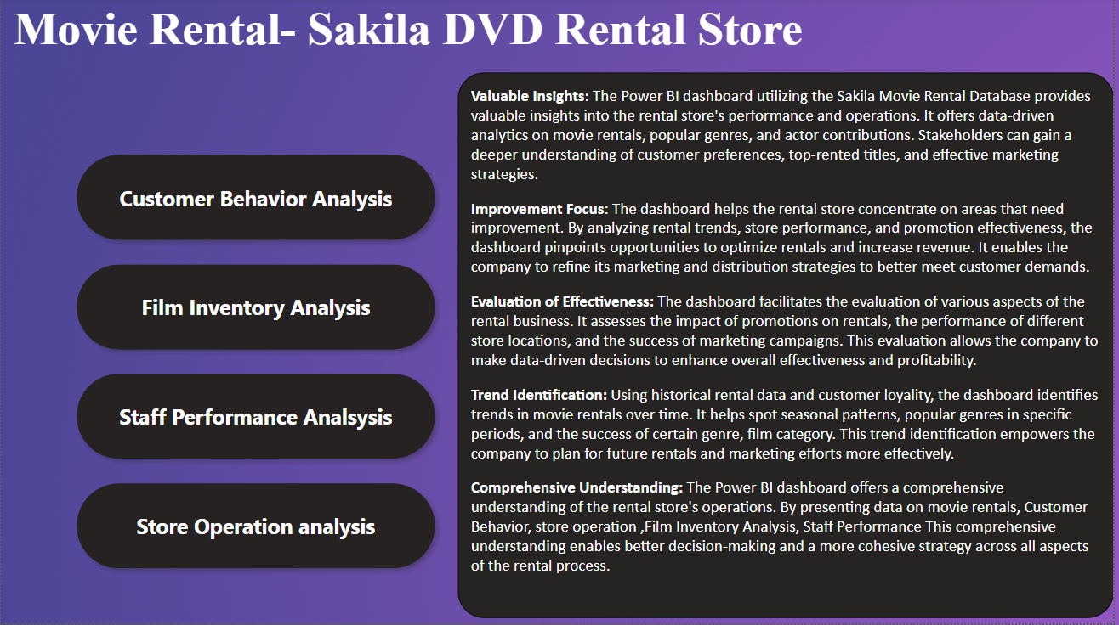

Slide 3
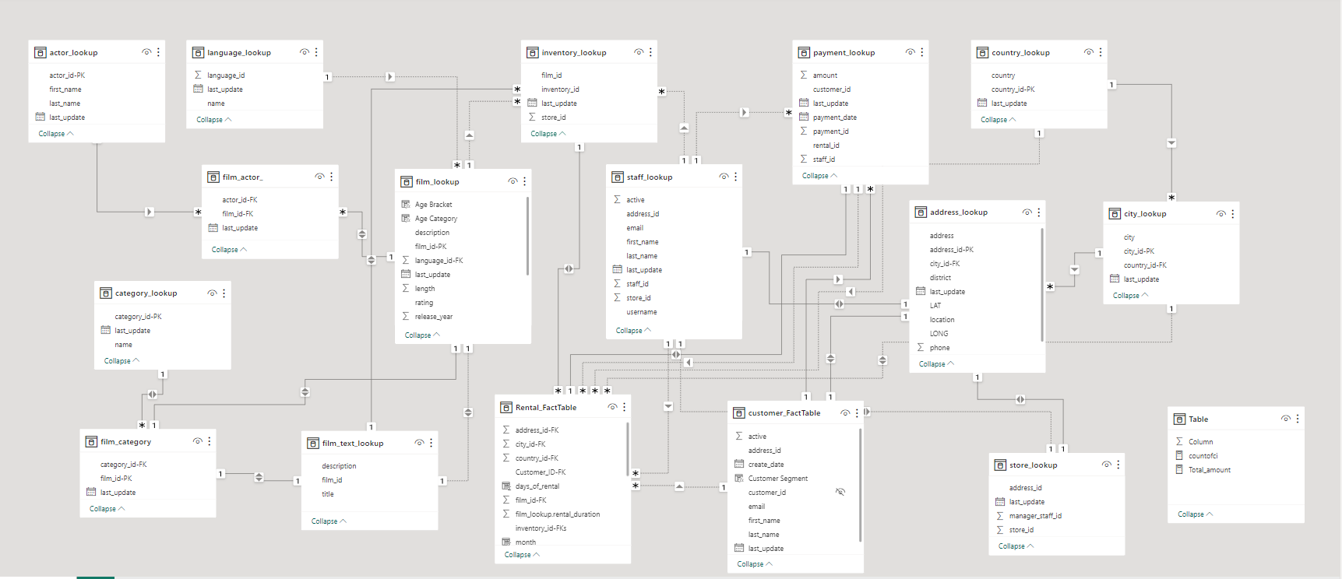
E-R DIAGRAM

Slide 4

Power BI Problem Statements

Slide 5
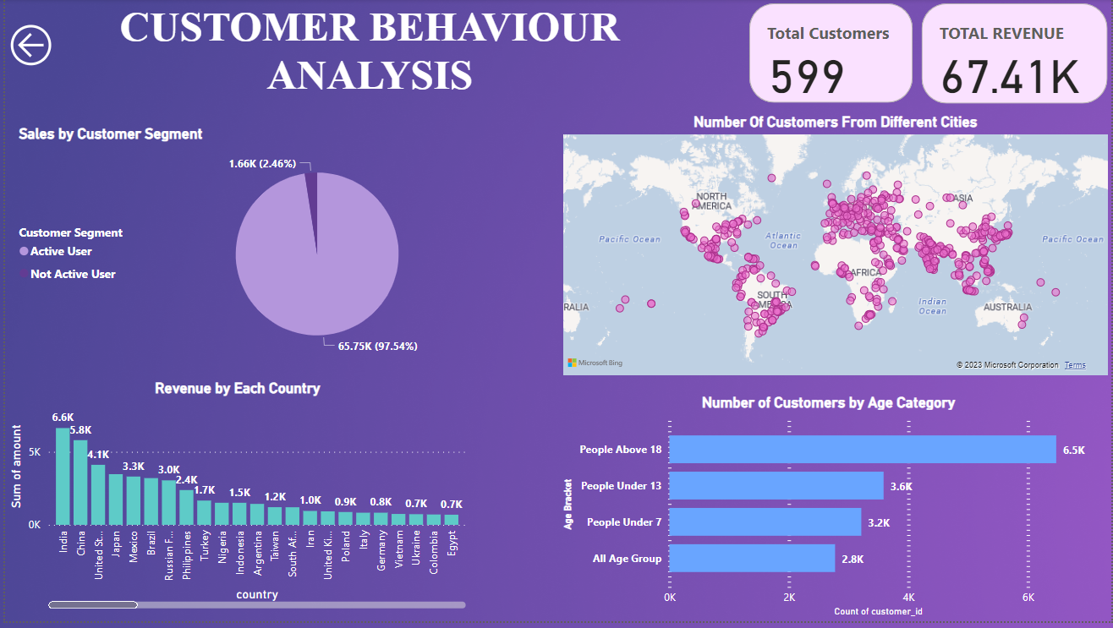

Slide 6
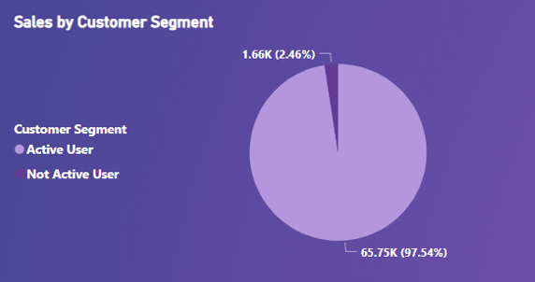
Which customer segments generate the highest sales?
The Active user segment, with a substantial sales figure of 65.75K, emerges as the primary revenue driver.
The Inactive User segment, with sales amounting to 1.66K, demonstrates a notably lower level of engagement and contributions.
The Active user is more dominant in order to generate the revenue for the store.

Slide 7
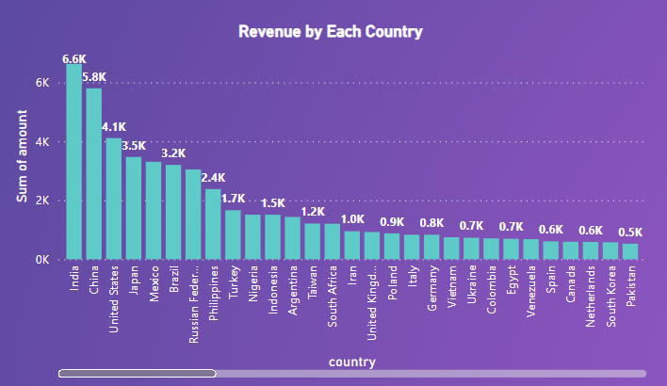
How does the rental revenue vary by country?
India and China generate the maximum revenue.
The USA, Russia, Japan, and Mexico following with substantial but comparatively lower revenue.
Countries like New Zealand and Greenland has the lowest revenue.

Slide 8
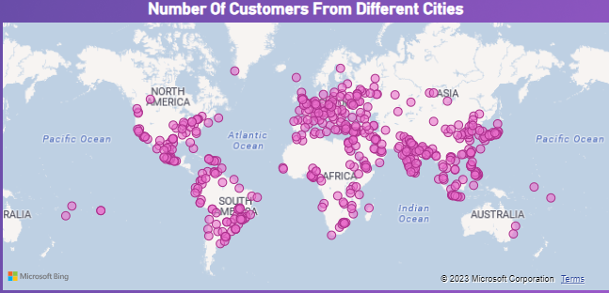
What is the distribution of customers across different cities?
Aurora and London Have two- two Customers, . These cities may offer unique attractions, higher population densities, or stronger business opportunities that draw more patrons
All other cities have only one customer , It could be due to geographical constraints, limited market presence, or simply a lesser customer base in those areas.

Slide 9
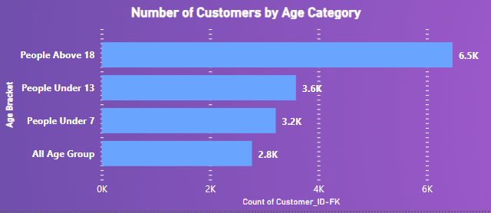
Analysis for the Number of rentals by the age category.
The significant number of rentals for individuals aged 18 years and above.
The 3.6K rentals for people under 13 years old indicate a notable presence of children as customers.
The All Age Group category people has the lowest number of rentals as compared to the other Category.

Slide 10
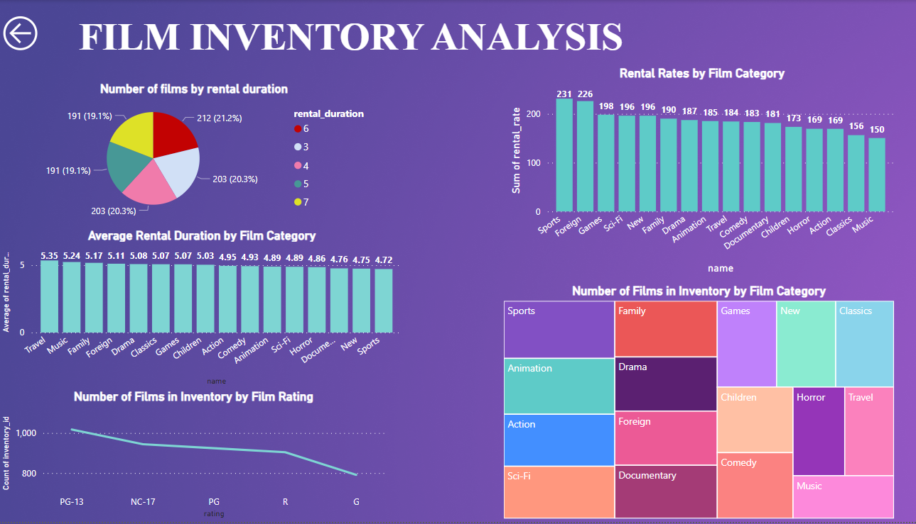

Slide 11
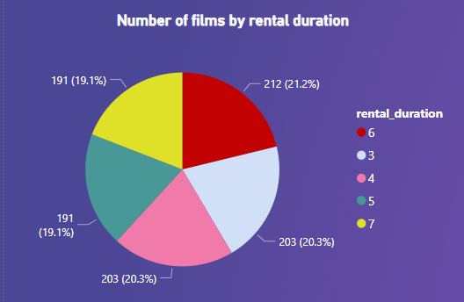
What is the distribution of films by rental duration?
The data indicates that the most common rental durations are 4 days and 3 days, each accounting for 20.3% of the distribution.
6 days and 7 days rentals make up 21.2% and 19.1% of the distribution, respectively. This implies that a considerable number of customers opt for slightly longer rental periods.

Slide 12
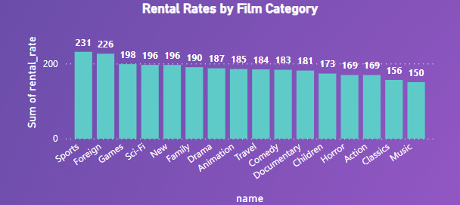
Which film categories have the highest rental rates?
The Sports and Foreign Film category emerges as the highest rental rate category, indicating a strong demand for content in these genres.
Followed by Games, Sci-Fi, New and Family Category.
Music and Classics film category has the lowest rental rates.

Slide 13
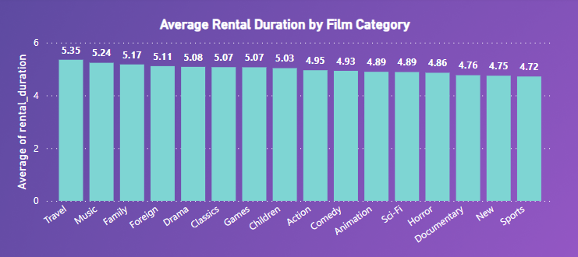
How does the average rental duration vary by film category?
Travel, Music, Family, and foreign boast the highest average rental durations.
Sports, New and Documentary has the lowest average rental duration as compared to other film Categories.

Slide 14
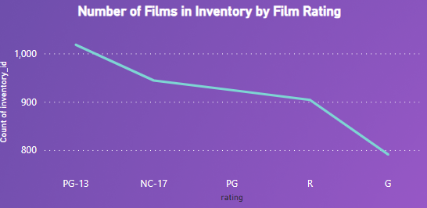
How does the inventory vary by film rating?
PG-13 has the highest number of films in inventories, with 1018, This suggests a significant prevalence of films with this rating in the inventory.
NC-17, with 944 inventory IDs, follows closely.

Slide 15
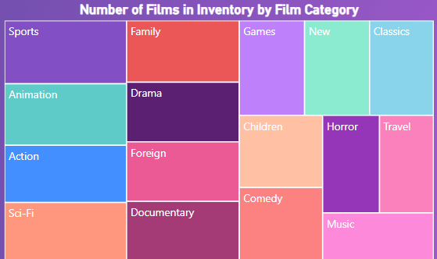
What is the breakdown of film categories in the inventory?
The categories "Sports," "Animation," "Drama," "Sci-Fi," "Family," "Action," and "Documentary" collectively have the highest number of films in stock.
Music, Horror, Travel has a low number of films in the stock.

Slide 16
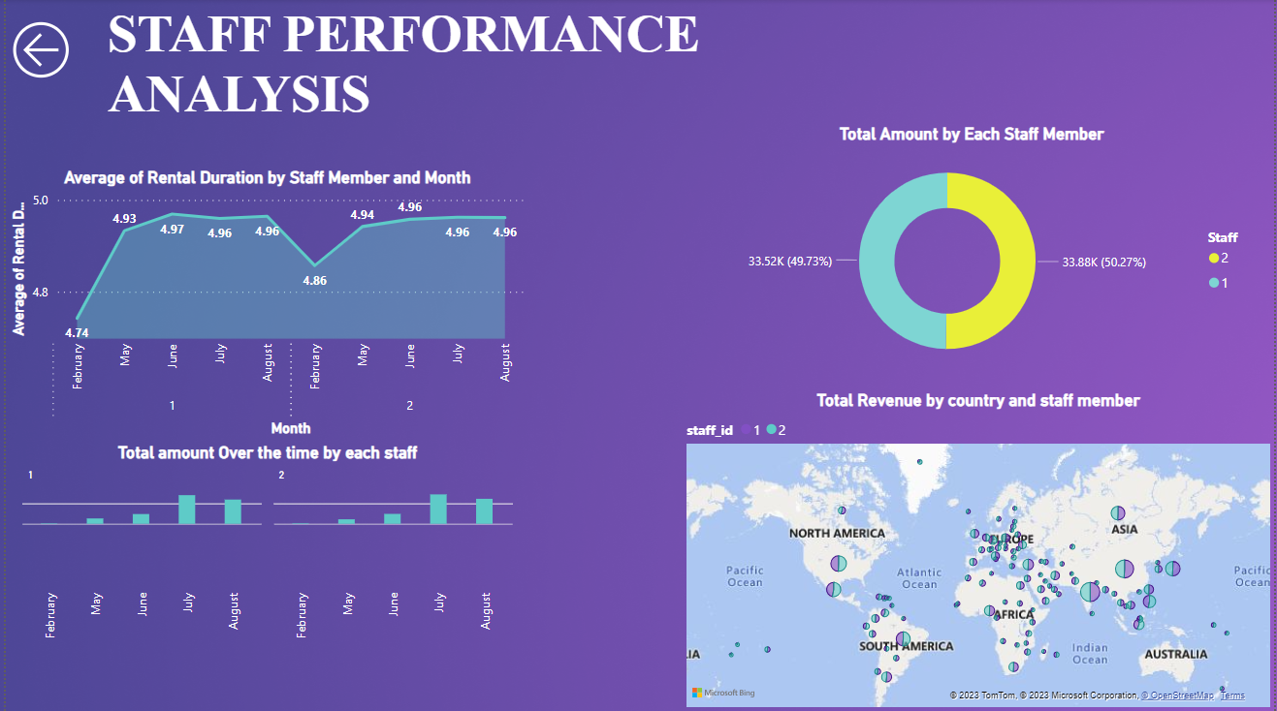

Slide 17
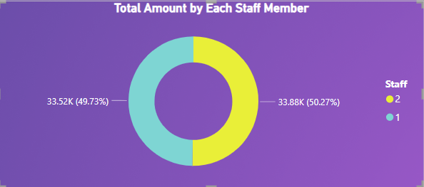
Analysis on Revenue Generated by each employee.
The data indicates that Staff 2 generated revenue totaling 33.88K, constituting 50.27% of the total revenue.
Staff 1 contributed 33.52K, accounting for 49.73% of the total revenue.
This balance indicates that both employees are instrumental in the overall financial success of the business

Slide 18
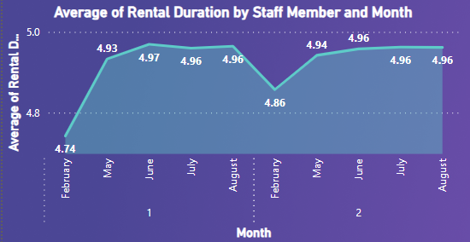
What is the average rental duration by staff member?
Staff 1 consistently maintains a fairly stable average rental duration from February to August, with a minor fluctuation of only 0.23 units over this period.
Staff 2 exhibits a similar trend but with even smaller variations, showing remarkable consistency with only a 0.1-unit difference between February and August.
This consistency might indicate that both staff members are handling rentals efficiently and consistently over time

Slide 19
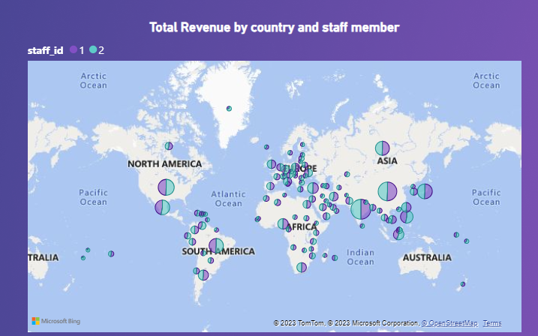
Staff Performance in Different Location
In countries such as India and China, and rest of Asian countries Staff 1 ,Staff 2 approximately equal in terms of revenue.
Staff 2 has more revenue in the North America Continent.
Staff 1 has dominant over staff 2 in the Europe Continent.

Slide 20
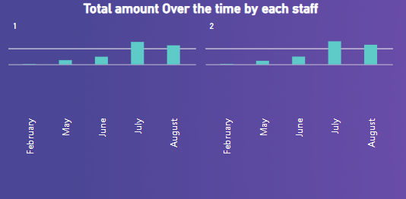
Analysis on Revenue Generated by each staff member over the time
For Staff 1, there is a clear upward trend in revenue from February to August.
The most significant growth observed in July.
Staff 2 exhibits a similar upward trajectory, albeit with a slightly slower rate of growth compared to Staff 1. The revenue increase from February to August.

Slide 21
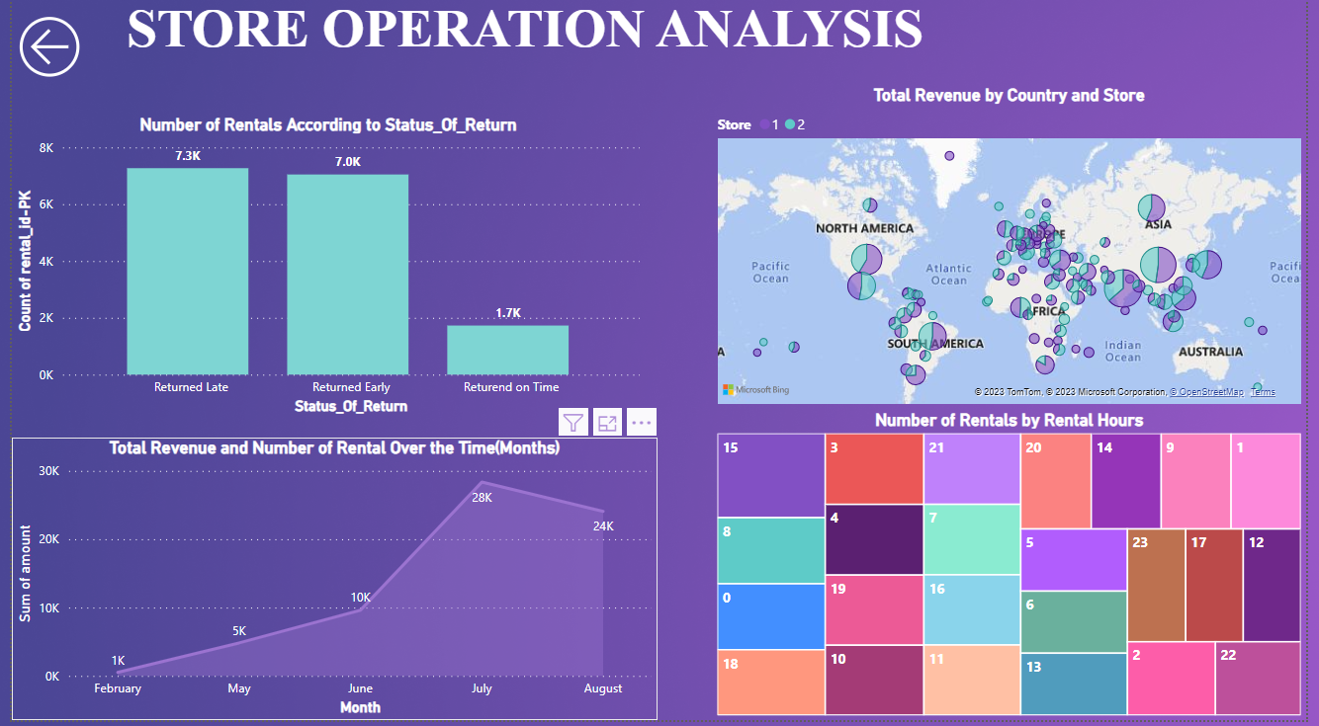

Slide 22
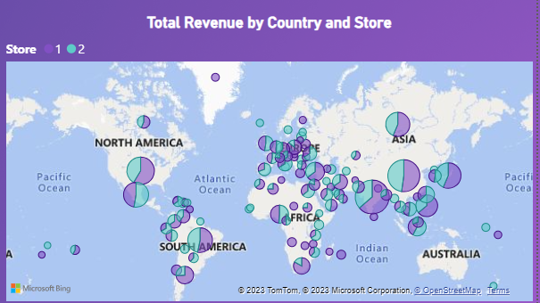
How does the store performance vary by location?
In countries such as India and China, Store 1 consistently outperforms Store 2 in terms of revenue.
This trend extends beyond these two countries, encompassing a broader global perspective, including Europe, America, and other regions.
Store 2 has dominant over store in the Africa and Europe Continent.

Slide 23
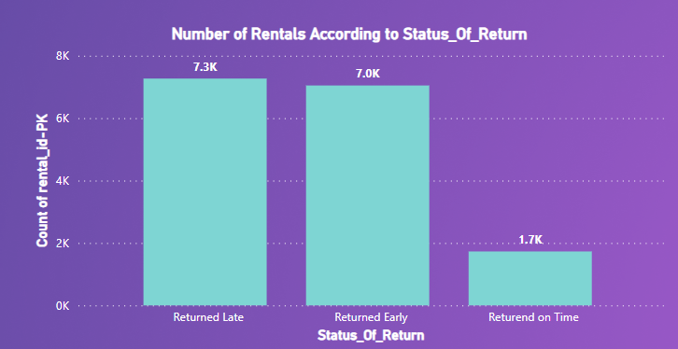
Analysis of Rentals by Return Status
Rentals by status of return
Approx. 50 percent of the rentals returned the films late.
Moreover, There are a huge number of rentals who returned the films earlier than return date.
There are less number of rentals who returned the films on time

Slide 24
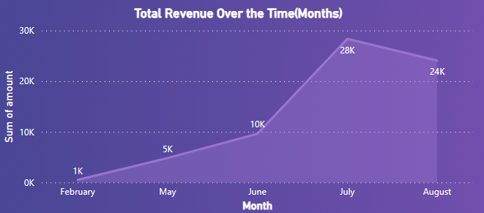
How does the sales revenue vary by month?
The Rental revenues inclining from February to July and then gradually declining from August onward.
July as the highest-earning month .
February has the lowest revenue.

Slide 25
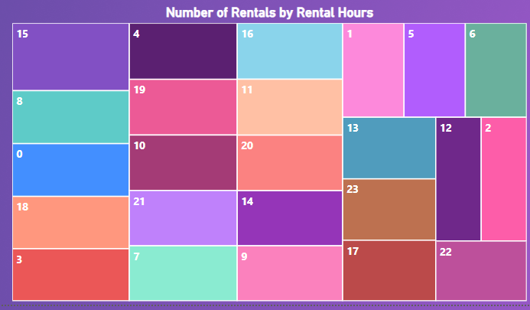
Rentals by Rental Hours
We have the maximum number of rentals in 15 hours i.e. 3 PM.
The Lowest Number of Rentals in 22 Hours i.e. 10 PM.
We have a Equal share of rentals in 8 AM, 12 AM, 6 PM (Time Zone Varies for Different Location)

Slide 26
Exploratory Data Analysis Questions

Slide 27
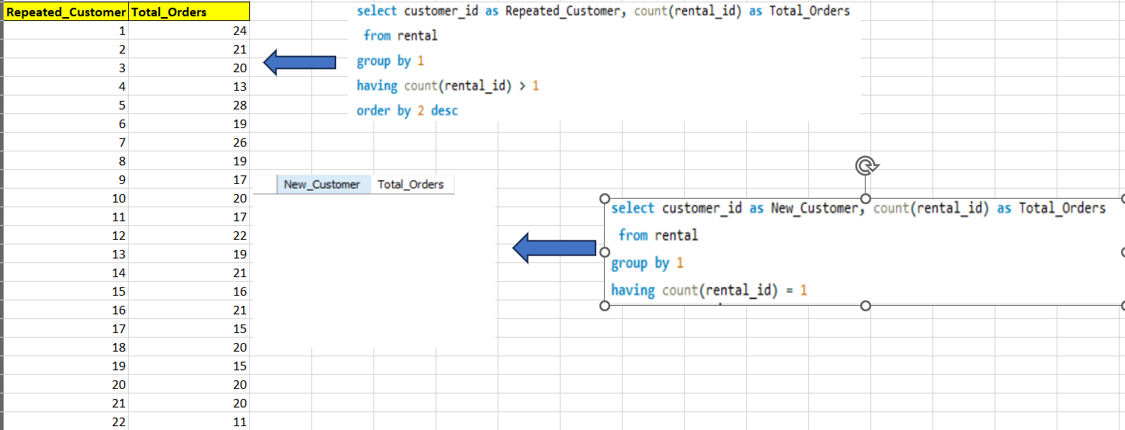
1. What are the purchasing pattern of new customers versus Repeating Customers?
There’s no new customer in the data we have only the repeated customer, Every customer rented films more than one time.
There’s no such customer in the data who rented film only one time.
Otherwise, We need any other relevant data for new customer, like category of customer as “New Customer” and “Old Customer”.

Slide 28
2.Which films have the highest rental rates and are most in demand?
The "Sports" category stands out by boasting both the highest revenue and the maximum number of rentals compared to other categories.
Additionally, several other categories, namely "Sci-Fi," "Animation," "Drama," "Action," and "Comedy," also contribute significantly to revenue generation.
One consistent aspect across all categories is the uniform highest rental rate of $4.99.

Slide 29
3. Are there correlations between staff performance and customer satisfaction?
There's no relevant data to solve this problem statement, we need the data for the staff performance and customer rating
Rentals by status of return
Approx. 50 percent of the rentals returned the films late.
Moreover, There are a huge number of rentals who returned the films earlier than return date.
There are less number of rentals who returned the films on time

Slide 30
4.Are there seasonal trends in customer behavior across different locations?
The Film rentals in both India and China show a strong preference for renting films during the autumn season.
By effectively catering to customer preferences during the autumn months, the film rental business can not only enhance customer satisfaction but also realize its revenue potential to the fullest.

Slide 31
5. Are certain language films more popular among specific customer segments?
The data reveals a critical aspect of the film rental business: it exclusively features English-language films.
There are maximum Active rentals who rents the films.
Only 3% of rentals are Inactive

Slide 32
6. How does customer loyalty impact sales revenue over time?
July, notably, emerges as the highest-earning month, characterized by both the highest total revenue and the greatest rental count.
It is apparent that revenue follows a seasonal pattern, with an upswing from February to July, followed by a gradual decline from August onwards.
Customer loyalty plays a pivotal role in the consistent growth of rental counts and total revenue.

Slide 33
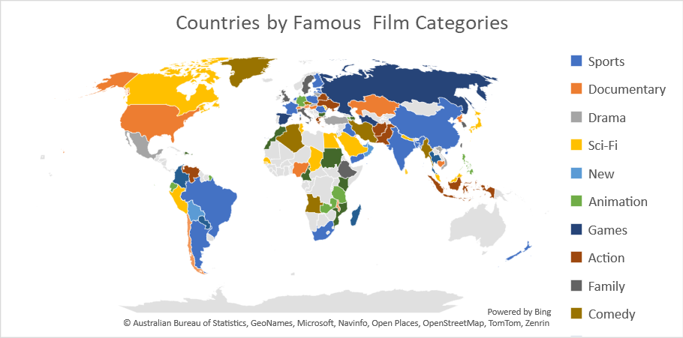
7. Are certain film categories more popular in specific locations?
The "Sports" category enjoys fame in India, while the "Drama" category stands out in Turkey.
We can see Sports Category is famous in many countries across the globe.
This approach not only aligns with customer demands but also showcases an understanding of the unique cinematic tastes in each region

Slide 34
8. How does the availability and knowledge of staff affect customer ratings?
We Can't solve this problem statement due to insufficient data, we need the customer ratings in order to solve this question.
Monthly Revenue Percent by Each Store
For Store 1, there is a noteworthy trend of substantial sales growth from May to July 2005,there’s a abrupt decline in sales in August 2005.
Store 2 also experienced growth from May to July 2005, which is a positive indicator of its performance, the sales remained relatively consistent between July and August 2005.
Both Store Faces a decline in August Month

Slide 35
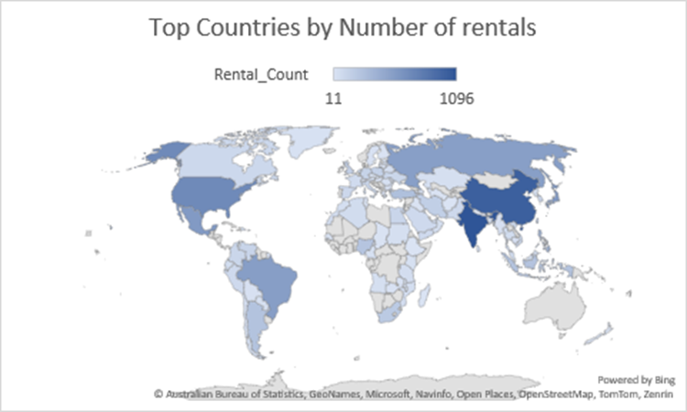
9. How does the proximity of stores to customers impact rental frequency?
We have the data to calculate the proximity between the customer location and store but there is no relation in that data. we have the location points for two stores only and we have approx. 600 customers from different location it has no relation between the user location and store location.
Alternate Analysis for Top Countries by Number of Rentals.
The data analysis clearly indicates that India stands out as the leading country in terms of film rentals, closely followed by China.

Slide 36
10. Do specific film categories attract different age groups of customers?
Firstly, individuals above 18 years of age exhibit the highest preferences for most genres, indicating a broad spectrum of interests.
People under 7 years tend to have the lowest preferences for many genres.
The age group between 7 and 13 years demonstrates a middle ground in genre preferences, showcasing a developing taste that bridges the gap between the very young and adult audiences.
The genre of "Animation" garners popularity across all age groups, with a particular appeal to those under 7 and above 18 years.
"Sports" content emerges as a strong preference for both individuals above 18 and under 13 years

Slide 37
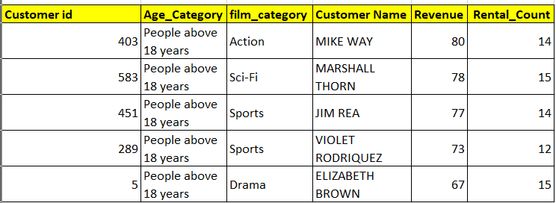
11. What are the demographics and preferences of the highest-spending customers?
The top spending customers consistently belong to the same demographic group – individuals above 18 years of age.
They favor genres like "Sports," "Action," "Sci-Fi," and "Drama" movies.

Slide 38
12. How does the availability of inventory impact customer satisfaction and repeat business?
To solve this problem statement, we don't have the relevant data we need the data for customer satisfaction to solve this problem.
The most popular genre in each store in terms of revenue and frequency.
For Store 1, the data reveals that the genre of "Drama" holds the top position in both revenue generation and rental frequency.
For Store 2, "Sports" emerges as the leading genre in terms of both revenue and rental frequency.

Slide 39
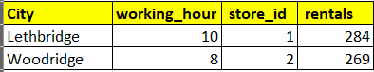
13. What are the busiest hours or days for each store location, and how does it impact staffing requirements?
Store 1 experiences its busiest hour at 10 AM in Lethbridge, signifying a significant influx of customers during that time.
Store 2 witnesses its busiest hour at 8 AM in Woodbridge.
This peak hour suggests that a substantial crowd converges on the store,
To efficiently manage the increased customer traffic during these peak hours, it is imperative to have an adequate number of staff members on duty.
Assigning experienced and skilled employees during these peak hours can be advantageous. They are more adept at handling the rush, addressing customer inquiries, and maintaining order in the store

Slide 40
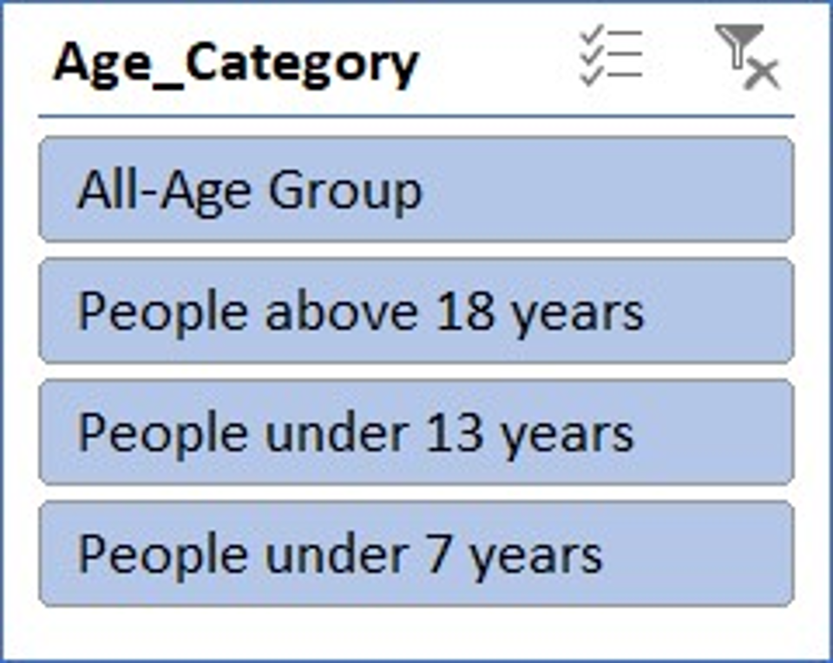
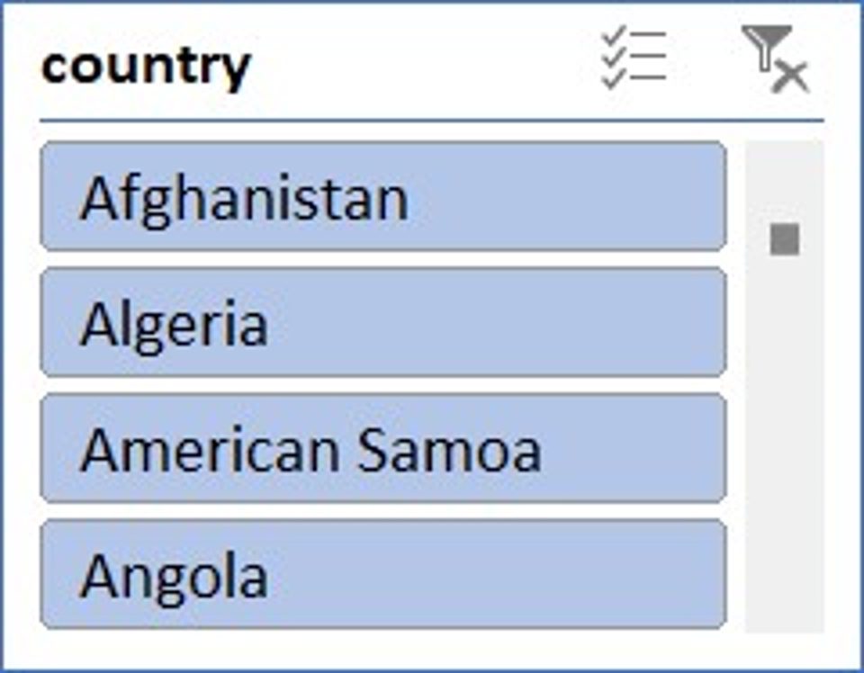
14. What are the cultural or demographic factors that influence customer preferences in different locations?
Film categories like "Music," "Games," "Sci-Fi," and "Documentary" emerge as universally popular, transcending geographical and age boundaries.
"People above 18 years," indicating that adults comprise the primary audience for movie rentals.
there is also notable engagement in the "All-Age Group" and "People under 13 years" categories.
Sports" enjoys popularity in China and India, aligning with the strong sports culture in these countries. In contrast, the United States leans towards "Games," reflecting the gaming culture prevalent there, while Brazil favors "Drama," .

Slide 41
15. How does the availability of films in different languages impact customer satisfaction and rental frequency?
To solve this problem statement, we don't have the relevant data of customer satisfaction and also, we have data for only one film language i.e. English. We need Data related customer satisfaction.
Top 10 customers according to total spending and Frequency
Karl Seal and Eleanor Hunt, who stand out in terms of their total spendings and rental frequency.
In addition, extending offers and coupons to the top 10 customers, who likely represent a significant portion of the store's revenue, can not only retain their loyalty but also act as a marketing strategy by setting an example for other customers

Slide 42
CONCLUSION
Our project on the Sakila Dataset has successfully leveraged SQL for comprehensive data analysis. Our customer behavior analysis identified rental trends, top spenders, customer segments, and age brackets, offering insights for inventory and marketing strategies. Store operation analysis revealed performance variations, guiding strategic decisions. Film inventory analysis pinpointed categories for optimization. Staff performance insights enabled efficient training. Power BI enhanced data visualization, and Exploratory Data Analysis further enriched our understanding. Through SQL proficiency, we addressed a wide range of questions. Sharing our methodologies and findings promotes knowledge sharing, underscoring the practical value of data analysis and SQL in informed decision-making.

Slide 43


